Slide 1
ML based Career Service Platform
Project Proposal
Team 1
INFO 7390 - Advanced Data Science
April 7, 2018

Slide 2
Project Proposal
MLBC is Web based platform for candidates who are seeking a job and recruiter who are looking for the right talent.
The platform scrapes and analyzes publicly available job posting data from sites like Glassdoor, LinkedIn, etc.
The system will recommend the candidate which job title will fit them based on their resume. The system will also give job links to the suitable for them.
The platform will also help us to gain statistical information about the latest job trend.

Slide 3
Steps Involved
Scrapping information and skill sets from websites such as Glassdoor
This will be done by giving the url as input to a web scraper
Library such as scrapy will be used to run multiple web crawlers on a single website to optimise scrapping process
Analysing the data and segregating the content to skills and tools mandatory and the expertise level
The data will be stored in either a mongoDB or MySQL database for further processing
To try out different machine learning models and hybrid techniques to optimise the result
To make a web based application to interact with the system through which the user can upload his/her data
Parse the users resume and scrape relevant information i.e. tools, skills, location, work experience and serve it as parameters for our prediction model.

Slide 4
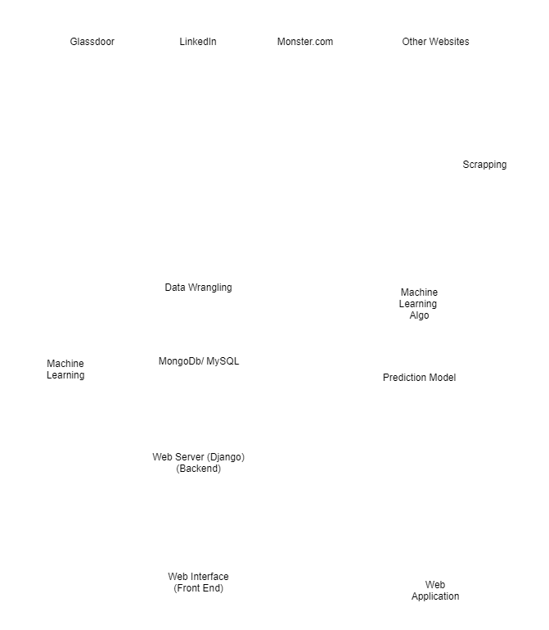

Slide 5
Use case
Discover and distinguish the most valuable skill and the most common skill like the Android and Big Data to Java.
User just have to upload their resume and everything else would be handled by the system, user won't have to write down the skills.
Predict salary expectation in different profiles and which is best suitable for that resume.

Slide 6
Deployment Details
Prototype
04
Docker
Develop the application and test different Models
Docker is an open source tool that automates the deployment of the application inside software container
01
03
Luigi
Amazon S3
Luigi is a Python package that helps you build complex pipelines of batch jobs. It handles dependency resolution, workflow management, visualization, handling failures, command line integration, and much more.
Amazon Simple Storage Service (Amazon S3) is a web service that provides highly scalable cloud storage. Amazon S3 provides easy to use object storage, with a simple web service interface to store and get any amount of data from anywhere on the web.
02

Slide 7



Stakeholders
The Supervising authority
The Supervising authority is a person that governs the entire system. Having supervisory powers over some aspects of management decision-making. Basically a person with more power than others.
The Beneficiaries (or users)
The beneficiaries (or users) are all natural persons or corporate body, students , recipients of the services provided by MBCS.
The Recruiters
A person whose job is to enlist or enroll people as employees as members of an organization.

Slide 8
Proposed Technology
We will be using python libraries to power this solution, such as:
SNo. | Library | Purpose
1. | Scrappy, Beautiful Soup and LXML | Web Scraping
2. | Scipy, Pandas, Seaborn | Data Analytics and BDA
4. | NLTK | Language processing
5. | Django | Web Server and application UI
6. | Docker | Container and Load Distribution
7. | Scikit Learn / Neural Networks | Machine learning
8. | Luigi | Pipeline
9. | Boto3 | Amazon S3 Upload

Slide 9
Project timeline
Day 1
Day 2 - 3
Day 4 - 6
Day 7 - 8
Day 9 -10
Write Scrapping code
Data Preprocessing and Exploratory Data Analysis
Model Building, Training, Selection
Deployment of models on cloud and build web application
System integration and documentation

Slide 10

https://www.kaggle.com/madhab/jobposts/data Thank you!

